Slide 1

Applied Machine Learning
Final Project Presentation - Group 4
Abhinav Anand
Abhishek Dubey
Manmohan Dash
- Sai Sandeep Sreevaschava Surabhi
Rahul Jain
Rucha Jadav Hrishikeshbhai

Slide 2

Project motivation
Implement the key concepts discussed in class and be able to interpret the results for making business decisions with integrity.

Slide 3

Agenda
DATA MINING OBJECTIVE
EXPLORATORY DATA ANALYSIS
DATA MINING ANALYSIS
MODEL EVALUATION
CONCLUSION

Slide 4

i. Data Mining objective
The objective of this project is to predict the likelihood of a customer making a purchase online based on various input parameters, including time spent on various webpages, geographical information etc. Additionally, this project aims to provide insights into the data by using the classification techniques, with the goal of improving business outcomes.

Slide 5
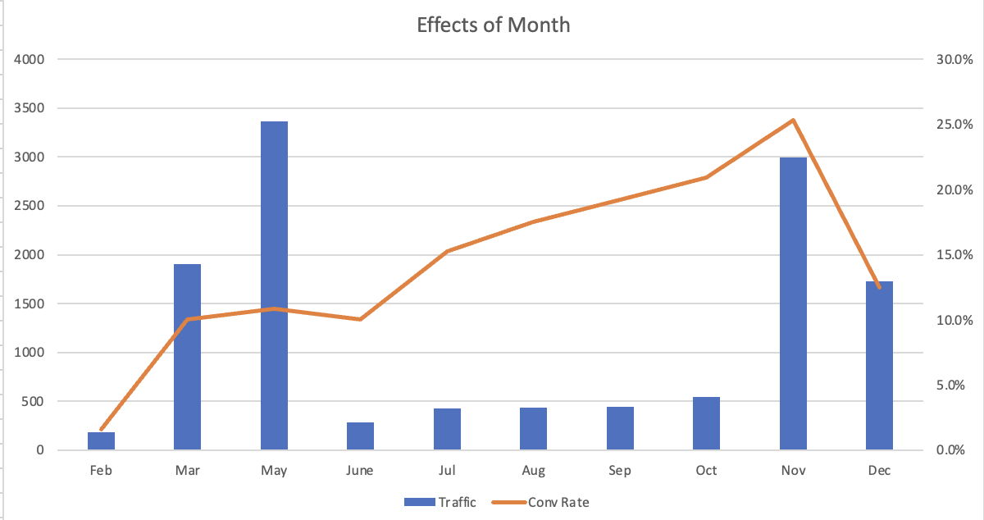
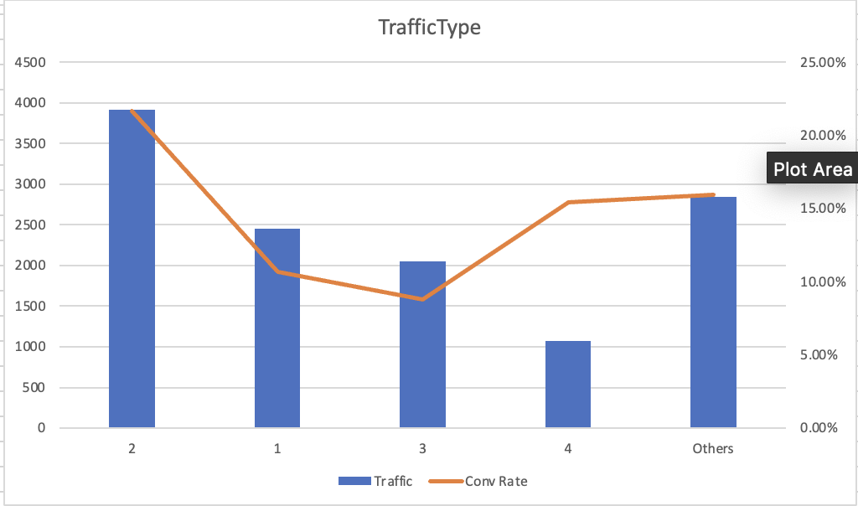
Ii. Exploratory data analysis
a) 1st Step: understand the Traffic count with respect to different variables
a.1 Traffic count by Month
a.2 Distribution of Traffic type
Seasonality: Seasonal trends in the dataset highlight strategic months, like November and December, which exhibit notably higher success rates for converting website visits into revenue, potentially aligned with holiday shopping seasons.
Traffic type: Different traffic types show substantial variation in conversion efficiency, with some demonstrating high revenue generation potential despite lower traffic volumes.

Slide 6
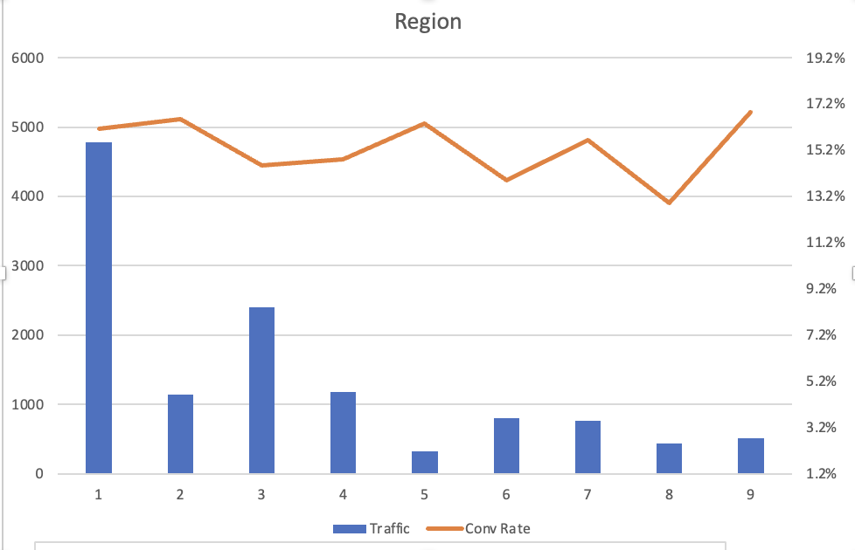
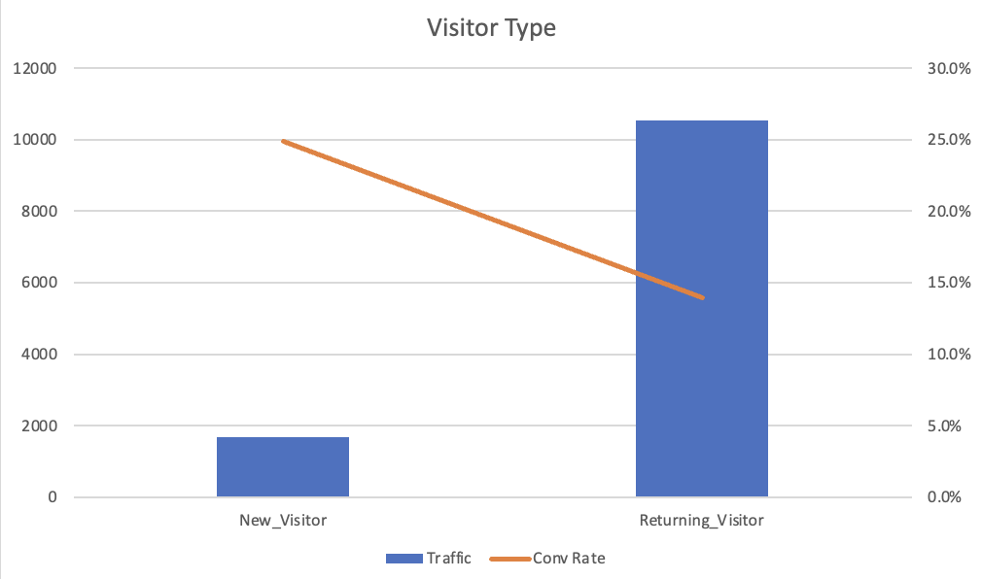
Ii. Exploratory data analysis
b) 2nd Step: analyze if there is seasonality, and which part of the week is dominant
b.1 Distribution of traffic count by region
b.2 analyzing the effect of visitor type on Traffic count.
Region: Region-based traffic analysis reveals that higher visitor counts do not necessarily correspond to higher revenue conversion rates, indicating opportunities for region-specific strategies to optimize conversion efficiency.
Visitor Type: This shows that returning visitors not only contribute to the majority of traffic but also have a success rate in making purchases close to the overall average, highlighting their importance in driving revenue.

Slide 7
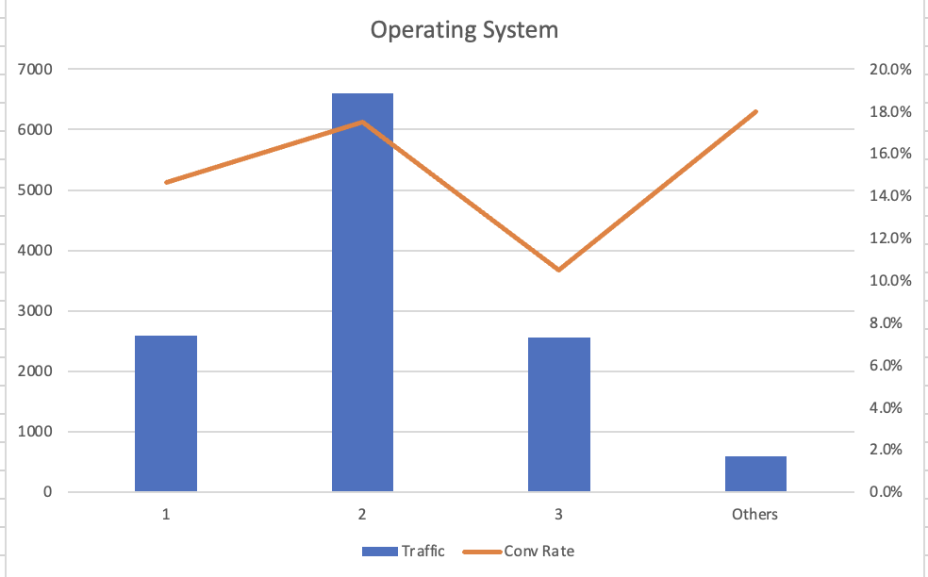
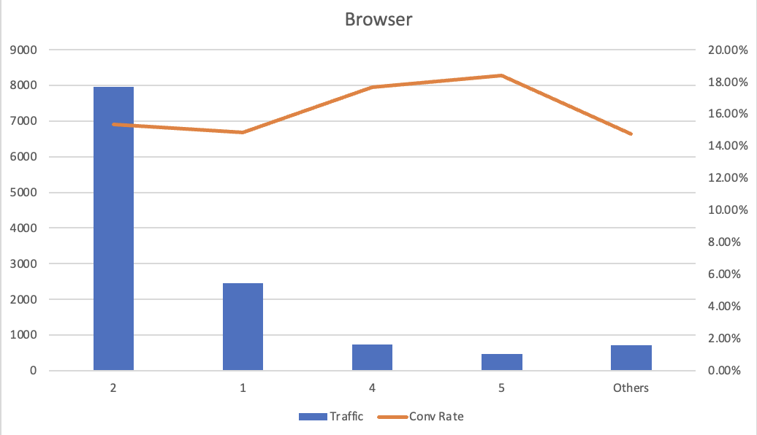
Iii. Exploratory data analysis
c) 3rd Step: analyzing the effect of type of Operating system and browser
c.1 Traffic count by Operating System
c.2 Traffic count by Browser
No Significant pattern: An analysis of traffic by operating system reveals that there isn’t any significant variation in revenue across different operating systems and browsers, although some categories have a few samples. Moreover, because of the confidentiality of the data less information can be interpreted.

Slide 8
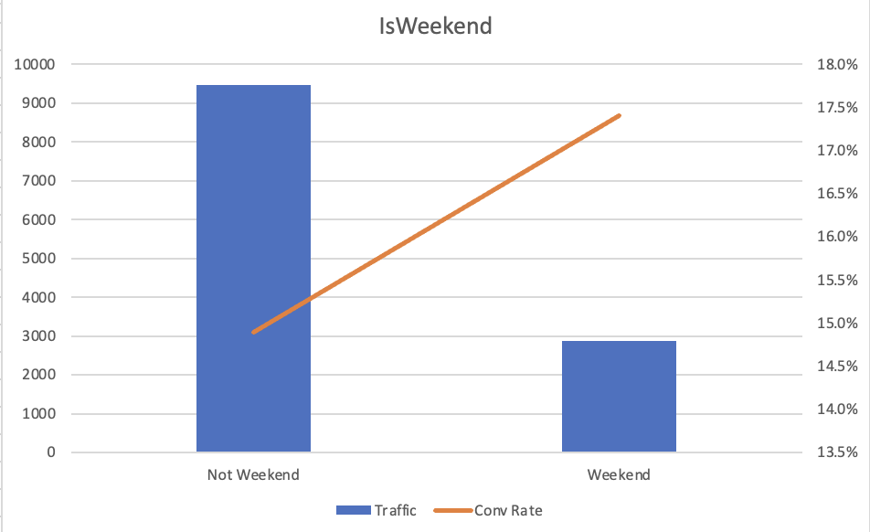
IV. Exploratory data analysis
d) 4th Step: Traffic count by Days of Week
Weekend Impact: Weekend visits, while fewer in number, show a marginally higher success rate in converting browsing into revenue, suggesting a quality-over-quantity dynamic that could inform targeted weekend marketing strategies.

Slide 9
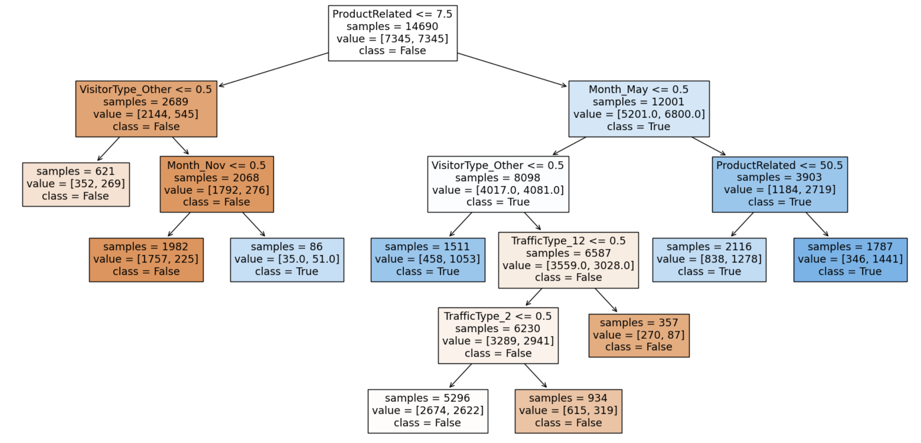
IV. Data mining analysis
Using Decision trees, we’re trying to classify the customers into True/False binary outcomes for the Revenue(dependent) variable.
Decision Trees
Max Depth: 5
Max Leaf Nodes: 9
Min Sample: 2

Slide 10
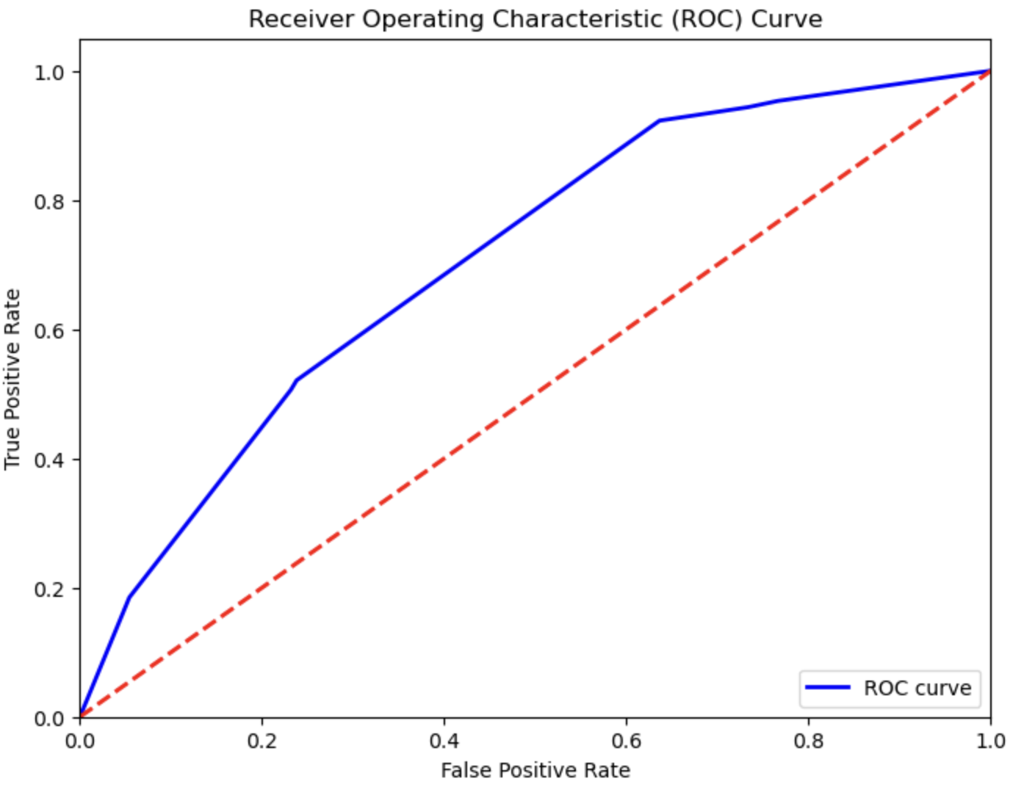
IV. Data mining analysis
Decision Trees contd.
Decision Tree
AUC: 0.707

Slide 11
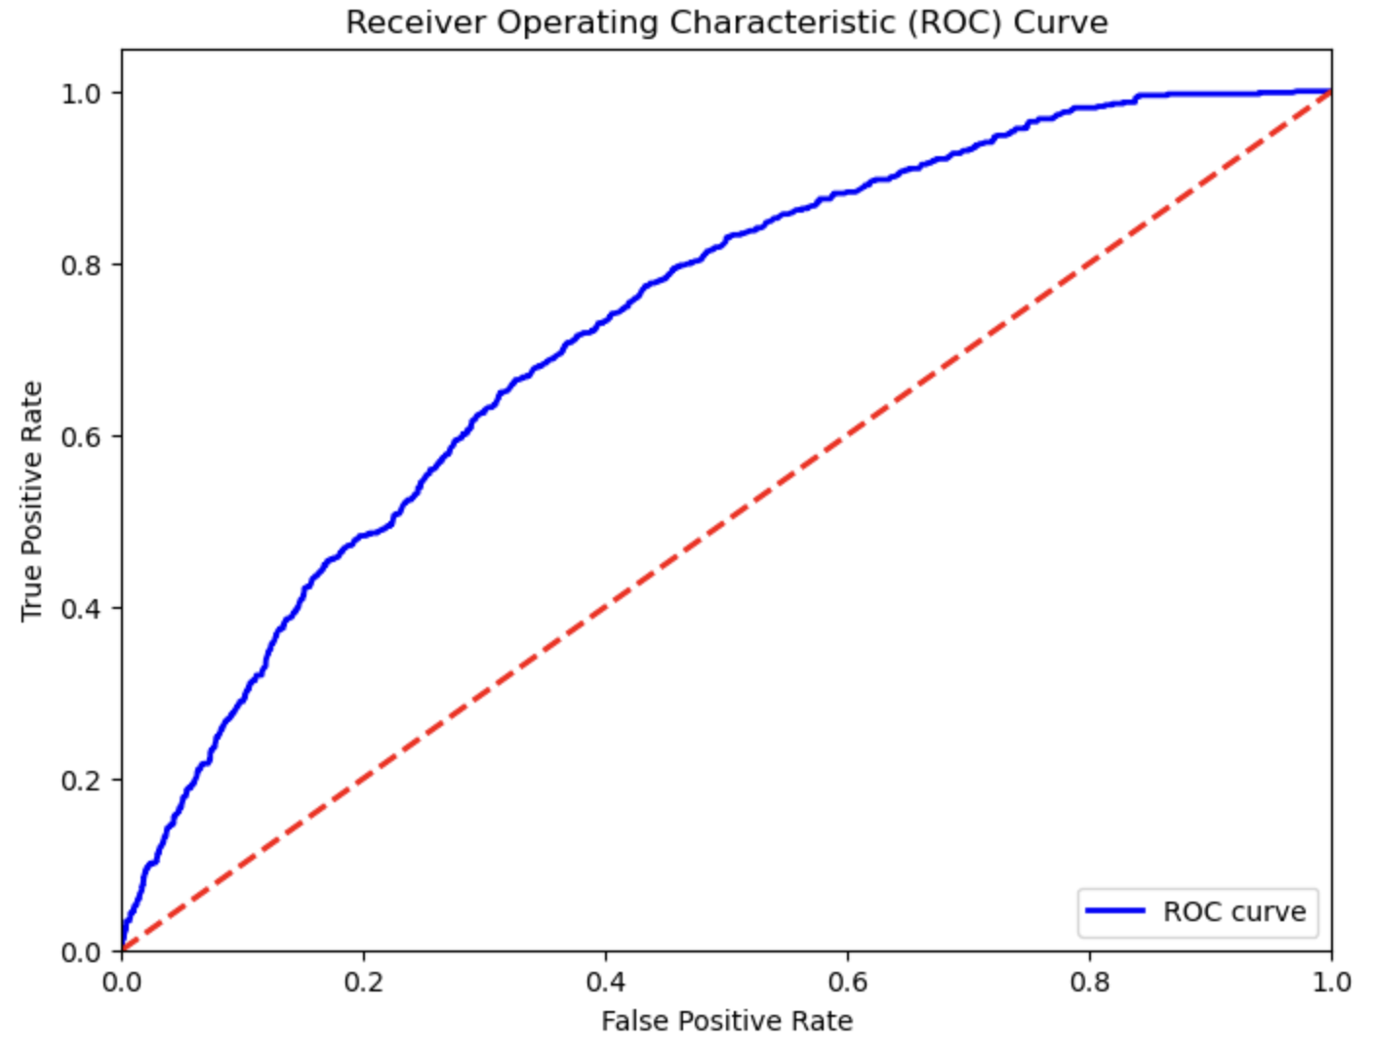
IV. Data mining analysis
c) Using Random forest, we’re trying to classify the customers into True/False binary outcomes for the Revenue(dependent) variable.
Random Forest
AUC: 0.729
Maximum Trees: 700

Slide 12
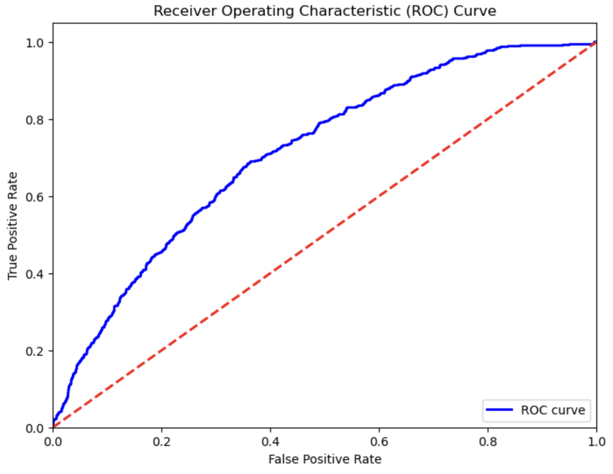
Iv. Data mining analysis
d) Using Adaboost classifier, trying to improve the metrics of classification for customers into True/False binary outcomes.
Adaboost
AUC: 0.713
Learning Rate: 1

Slide 13
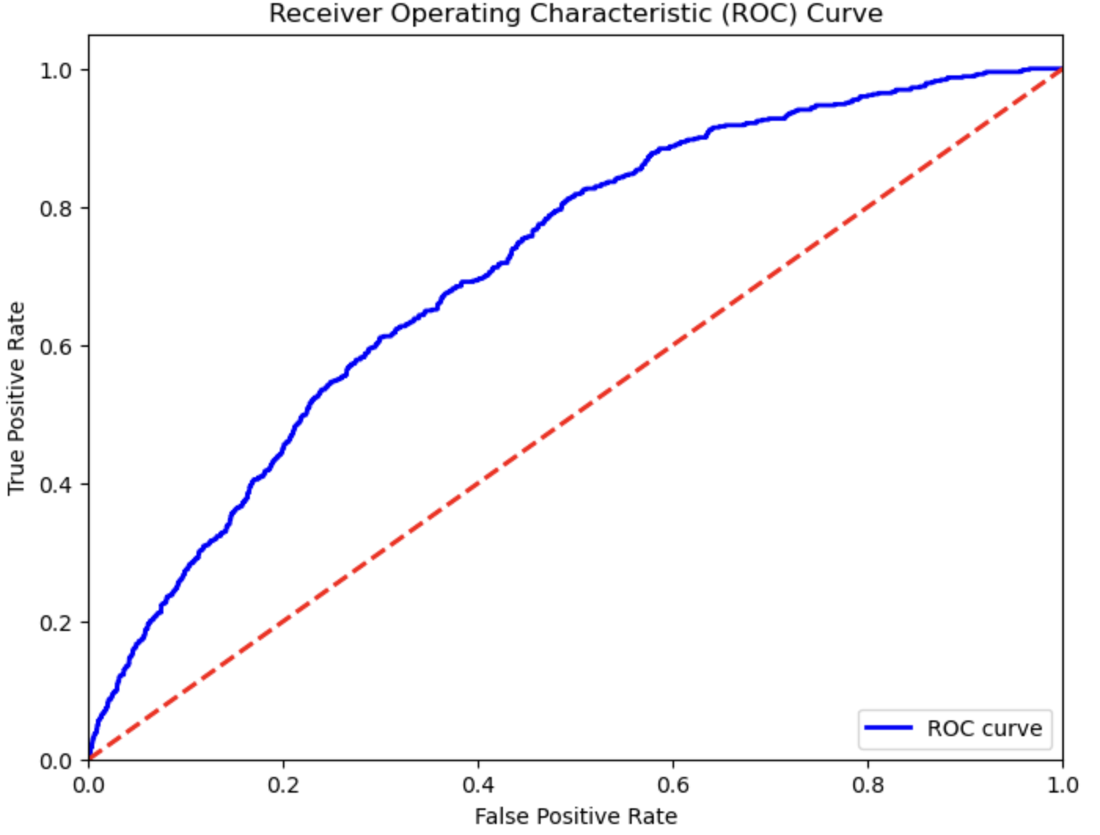
IV. Data mining analysis
Predicting the likelihood of customers making a purchase on the e-commerce platform using Logistic Regression.
Logistic Regression
AUC: 0.714
Penalty: L2 (Ridge)

Slide 14
Iv. Data mining analysis
Predicting the likelihood of customers making a purchase on the e-commerce platform using Logistic Regression.
Features | Odds | 1-x
Browser_13 | 2.5979 | 1.5979
Browser_12 | 2.5133 | 1.5133
TrafficType_16 | 2.468 | 1.468
TrafficType_7 | 2.1187 | 1.1187
Month_Nov | 1.8606 | 0.8606
TrafficType_15 | 0.1415 | 0.8585
TrafficType_8 | 1.8194 | 0.8194
Month_Feb | 0.2481 | 0.7519
TrafficType_18 | 0.3835 | 0.6165
TrafficType_13 | 0.4264 | 0.5736
TrafficType_5 | 1.5696 | 0.5696
Month_Oct | 1.5088 | 0.5088
OperatingSystems_5 | 0.5005 | 0.4995
Browser_11 | 0.5005 | 0.4995

Slide 15
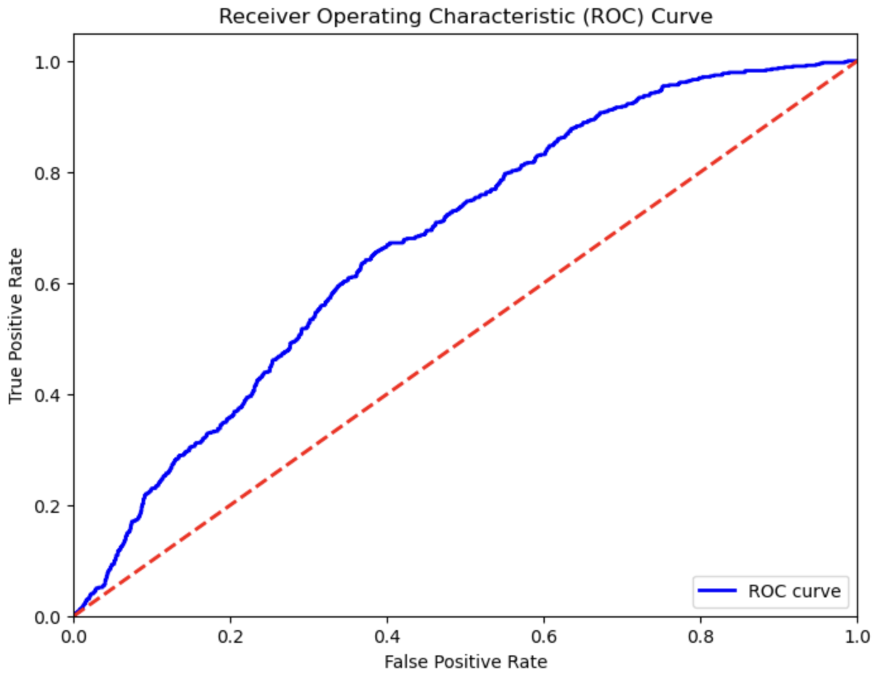
Iv. Data mining analysis
d) Using Neural Network classifier, to automate feature extraction.
Neural Network
AUC = 0.674
Layer Configuration:
200, 100, 50

Slide 16
iV. MODEL EVALUATION
Model Selection based on Evaluation Metrics: We used the ROC curve as an evaluation metric for model selection. And based on that random forest outperformed with an excellent value above 0.729, making it the preferred choice, followed by decision trees.
Preference for Decision trees: We are opting for decision trees due to its simplicity and interpretability. We can leverage its predictive power to focus on improving classification for better segmentation of users.

Slide 17
V. CONCLUSION
Based on our Analysis and Model, we recommend the following:
Identifying Users with High Conversion Probability: A measure to see when the user is in the initial stages of visiting the website, should the user be nudged to take a primed action to improve the chances of conversion? This is important to identify and manage the natural progression of easy to convert users and provide support to low conversion probability users.

Slide 18
THANK YOU

